Slide 1
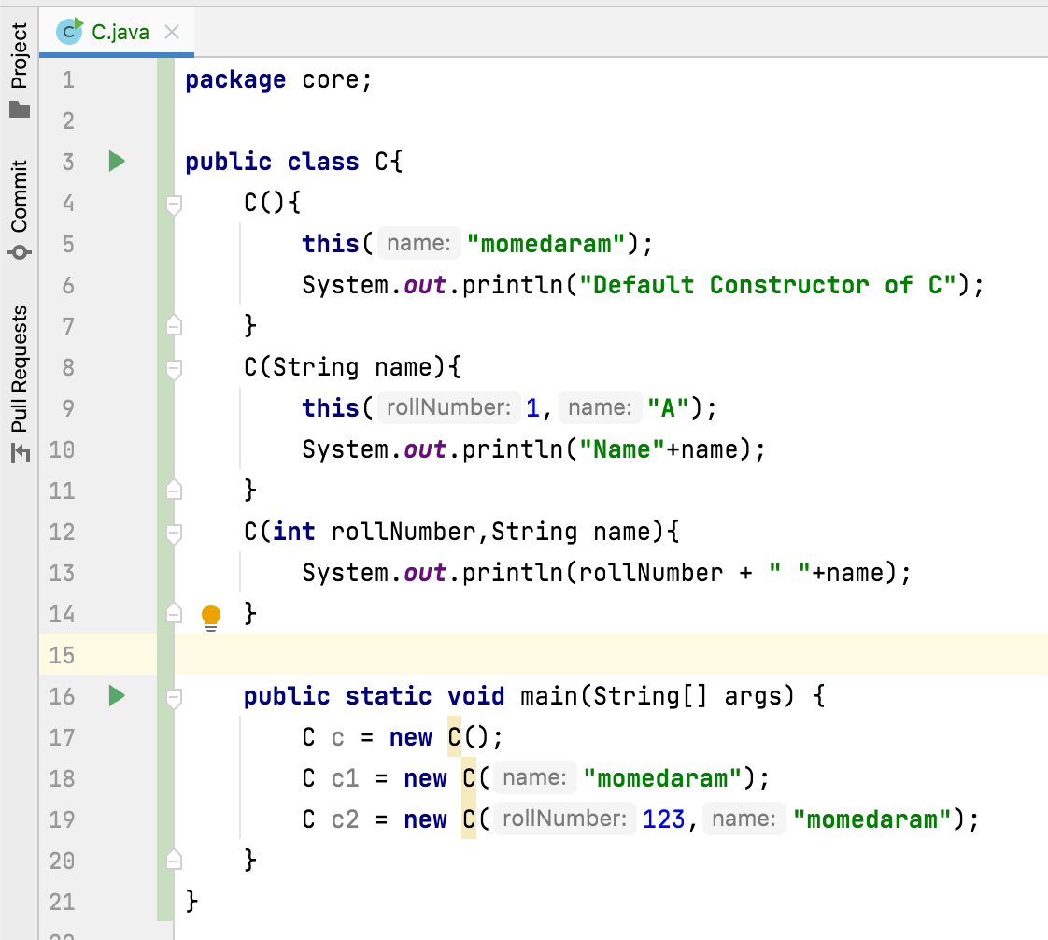
What is the constructor overloading? What is the use of constructor overloading?
A class can have any number of constructors.
These constructors will have different number of arguments. It is called constructor overloading.
Constructor overloading provides different ways to instantiate a class.

